Slide 1
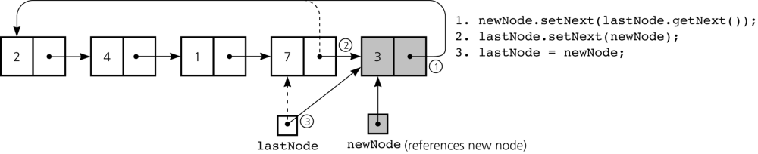
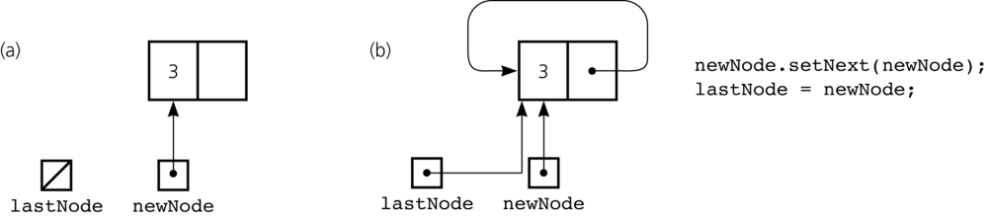
Implementing a Queue using a Linked List
Inserting an item into a nonempty queue
Inserting an item into an empty queue: a) before insertion; b) after insertion

